Slide 1
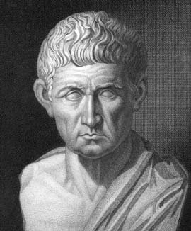

Data Semantics and Semantic Annotation
Mark Schildhauer OSS Training Institute 2
July 28, 2014

Slide 2
Learning Objectives
More formally understand what data “are”
Develop a better mental model for your own and others’ data
Become more familiar with what is meant by formal ontologies and reasoning
Understand what is meant by “semantics” and the need for “semantic annotation”
Get excited about the Semantic Web

Slide 3
Fundamental Problem: Big Data
Ecological/biodiversity data are Big Data:
globally distributed, voluminous
highly heterogeneous in structure and content
rapidly growing!
i.e., the 3 “V”s:
Volume
Variety
Velocity

Slide 4
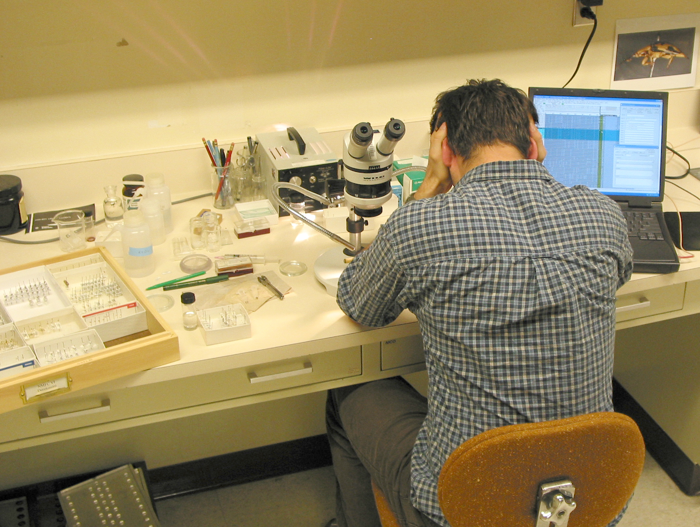
Fundamental Problem: Big Data
Finding, interpreting, and integrating the Data you need becomes a Big Challenge

Slide 5
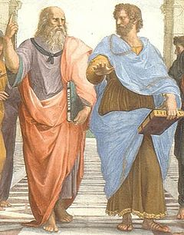
Semantics can help
Plato:
Forms, ideas
Aristotle:
Matter, identity, change
Forms/ideas embodied in matter and change:
the physical world & focus of Scientific Investigation
Notes:
Do not underestimate how relevant these two thinkers are in structuring our views of the world, even today!

Slide 6
Semantics can help
Category
Metaphor
Hypothesis
Quantity
Quality
Genus
Species
Subject
Predicate
Object
Verb
Forms/ideas embodied in matter and change:
the physical world & focus of Scientific Investigation
Notes:
Aristotle conceived of or clarified all the terms listed above, although these terms have etymological roots that may be Greek or later more popular Latinized variants!!!

Slide 7
Semantics can help
Help discover, integrate data exposed on the Web:
Metadata and keywords were a start
Controlled vocabularies: an improvement, but can do more with today’s technology
Ontologies: based on W3C standards—RDF, SKOS, RDFS, OWL
Modeling concepts in a domain for
heuristic and pedagogical value

Slide 8

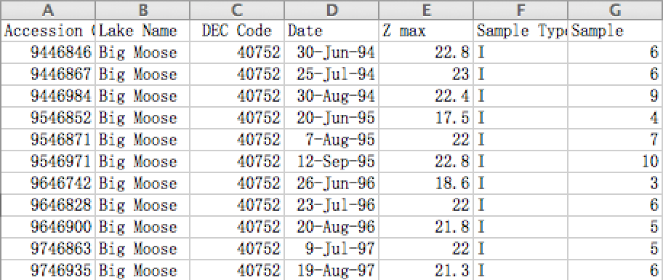
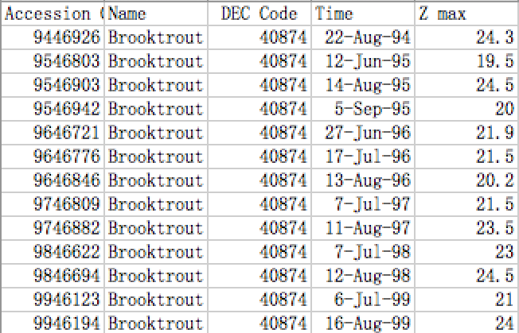
Semantics Challenges
Data Discovery and Interpretation is difficult due to the vastly heterogeneous data of Ecological and Environmental sciences, arising from
Independent Schemas and Vocabularies
Lack of (consistent) Annotation Mechanisms
Lack of Platforms/Tools Implementing Solutions
same?

Slide 9
How can formal ontology help
When we annotate data how do we know which definition is being referred to?
Incumbent upon scientists to clearly and formally define terms if they want to enable data discovery and integration
Formal ontologies can help by restricting interpretation of terms toward their intended meanings

Slide 10
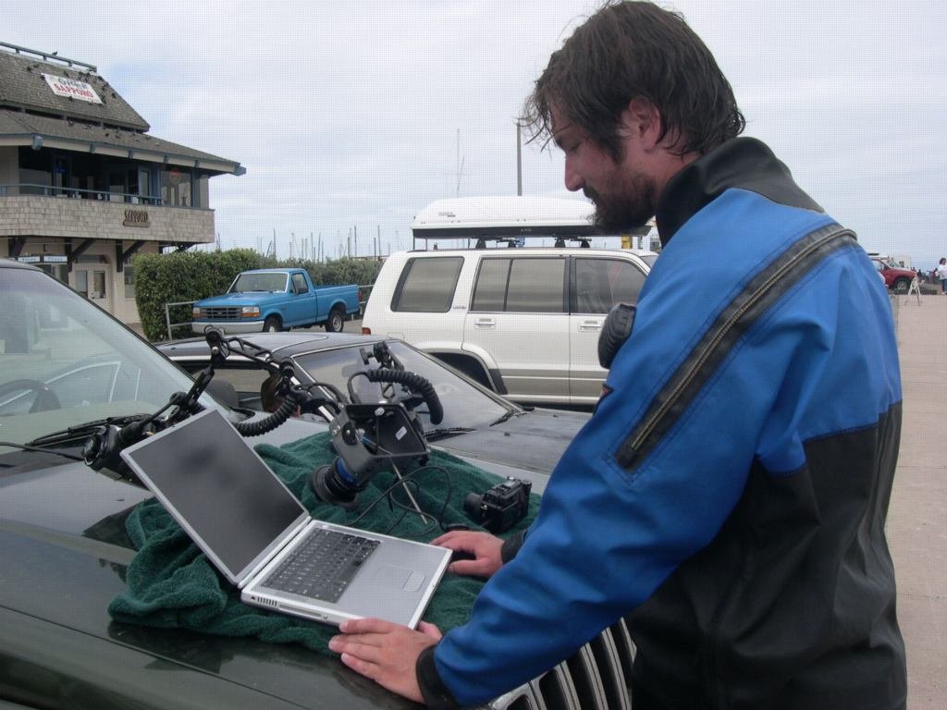
Epistemology
“Such evidence, as there is and ever was, collectively, for the whole overwhelming edifice of science, has consisted only in the direct evidence of many people’s senses”
W.V. Quine & J.S. Ullian, “The Web of Belief”
Also see:
http://plato.stanford.edu/entries/epistemology-naturalized/

Slide 11

Ontology
“To be is to be the value of a bound variable”
W.V. Quine, “On what there is” (1948)
Notes:
One of the greatest philosophers of the 20th century, Quine thought deep and hard about “what there is”, and grounds his beliefs in this slogan where he is basically addressing notions about 1) the ability to talk about the existence of non-existing things (unicorns or specifically, Pegasus!); and 2) whether there “exist” universals such as “red color” (see, the figure on the unicorn wasn’t gratuitous!). In both cases, he asserts that it is better to talk of descriptions–1) “something that is a winged horse captured by Bellerophon”,or 2) “something that is shared among red houses and red skirts”. Scientists might want to think a bit about their ontological assumptions regarding the “things/attributes” they measure…

Slide 12
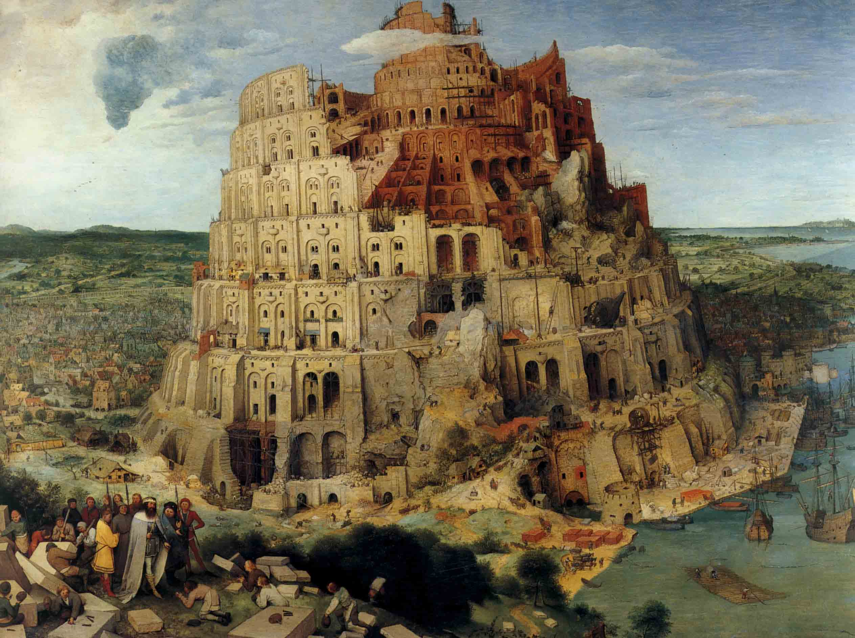
Semantics can help
Notes:
Tower of Babel, Pieter Brueghel the Elder, 1563

Slide 13
Semantics can help
Improving science through technology!!
Combining
FORMAL LOGIC
with
FORMAL CONCEPTS
Notes:
Tower of Babel, Pieter Brueghel the Elder, 1563

Slide 14
CONCEPTS
Notes:
Concepts are “mental representations” of….?

Slide 15
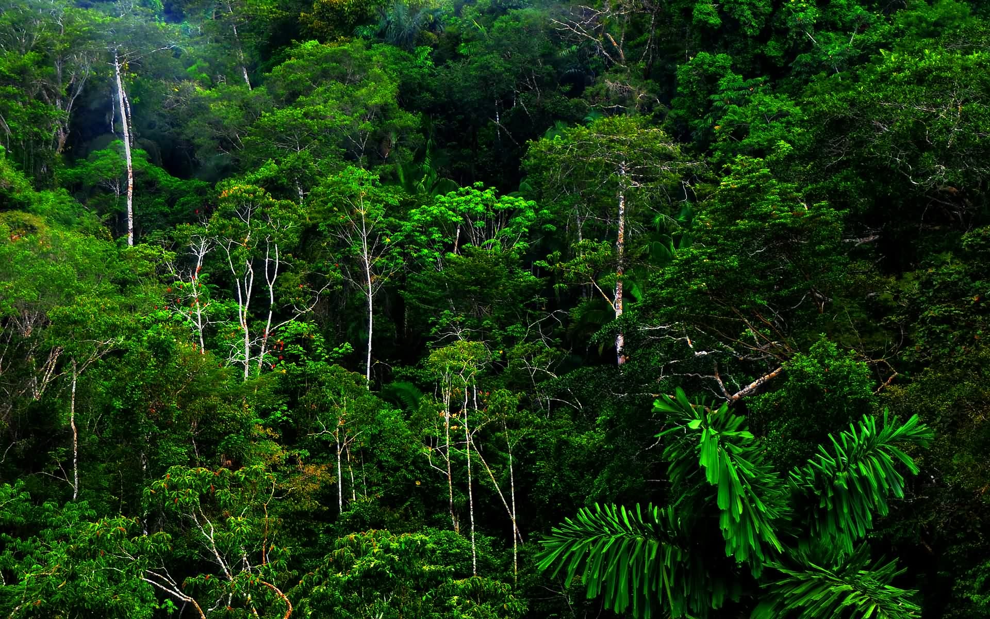
CONCEPT: Forest

Slide 16
Why formal definitions?
We study deforestation, mountain microclimate, and rural economics, etc.
Refer to terms forest, mountain, and town
Forests, mountains, and towns are classes (categories) of instances
We use these categories to communicate the results of scientific work
But they are often not well defined

Slide 17
Example: studying emission sinks from forestry activities:
Definitions of Forest, Deforestation, Afforestation, and Reforestation
[Lund 2007] found over 720 definitions of forest!
Different sources have different definitions
Geographic variation
Legal variation
Land use vs. land cover
Impediment to synthetic research

Slide 18
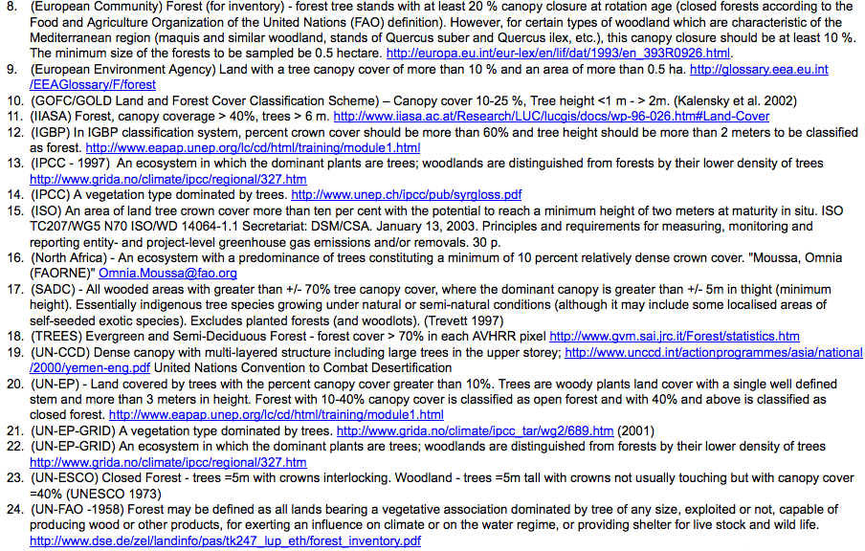
“I think I shall never see, a poem as lovely as some trees”
* Lund, H. Gyde. 2007. Separating the Cows From the Trees: Toward Development of National Definitions of Forest and Rangeland.
Notes:
Concepts that we use so readily in ecology, can become more challenging and ambiguous the more closely we examine them.

Slide 19
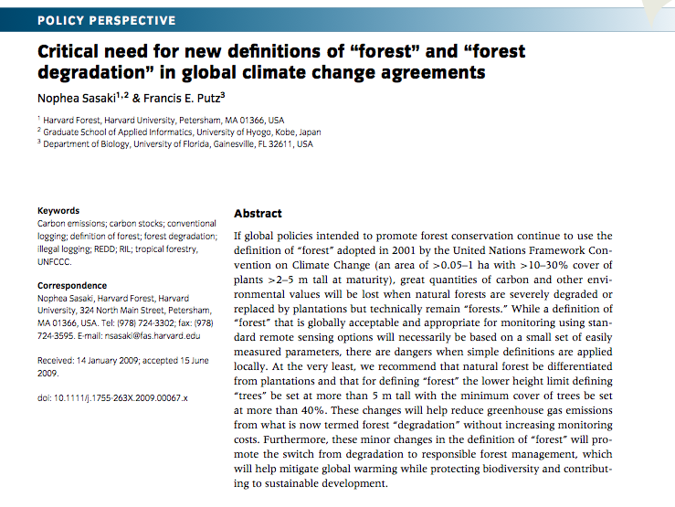
Sasaki, N., Putz F.E. (2009) Critical need for new definitions of “forest” and “forest degradation” in global climate change agreements. Conserv Lett 2, 226–232.

Slide 20
LOGIC
Notes:
Formal, mathematical rigor that machines (computers) can deal with

Slide 21
Logical proposition
Statement that has a truth value (true or false)
“bivalent logic”
Can be statement of fact
“A: Parasitic wasps are a type of parasite”
Facts can be compound
“B: All types of parasites have hosts”
Propositions represented by a symbol (A, B)

Slide 22
Binary logic
We can combine propositions to make more complex statements of fact
NOT A – true if A is false
A AND B – true if both A and B are true
A OR B – true if either A or B is true
A implies B

Slide 23
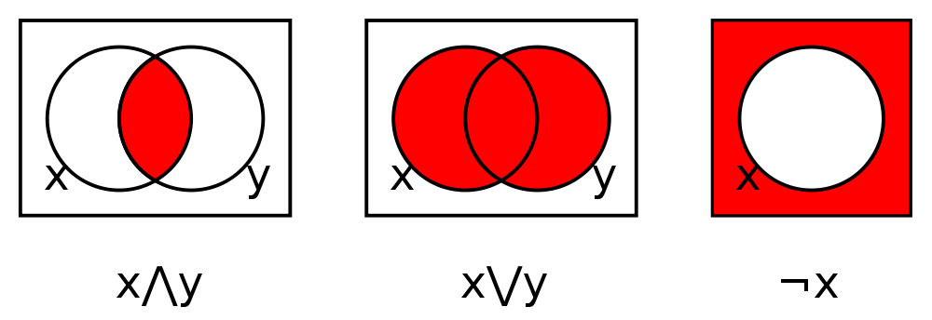
Related to Set Theory

Slide 24
Ternary logic
True, False, and Unknown
Used in SQL to reason about NULL values
A | B | A OR B | A AND B | A = B
True | True | True | True | True
True | False | True | False | False
True | Unknown | True | Unknown | Unknown
False | True | True | False | False
False | False | False | False | True
False | Unknown | Unknown | False | Unknown
Unknown | True | True | Unknown | Unknown
Unknown | False | Unknown | False | Unknown
Unknown | Unknown | Unknown | Unknown | Unknown

Slide 25
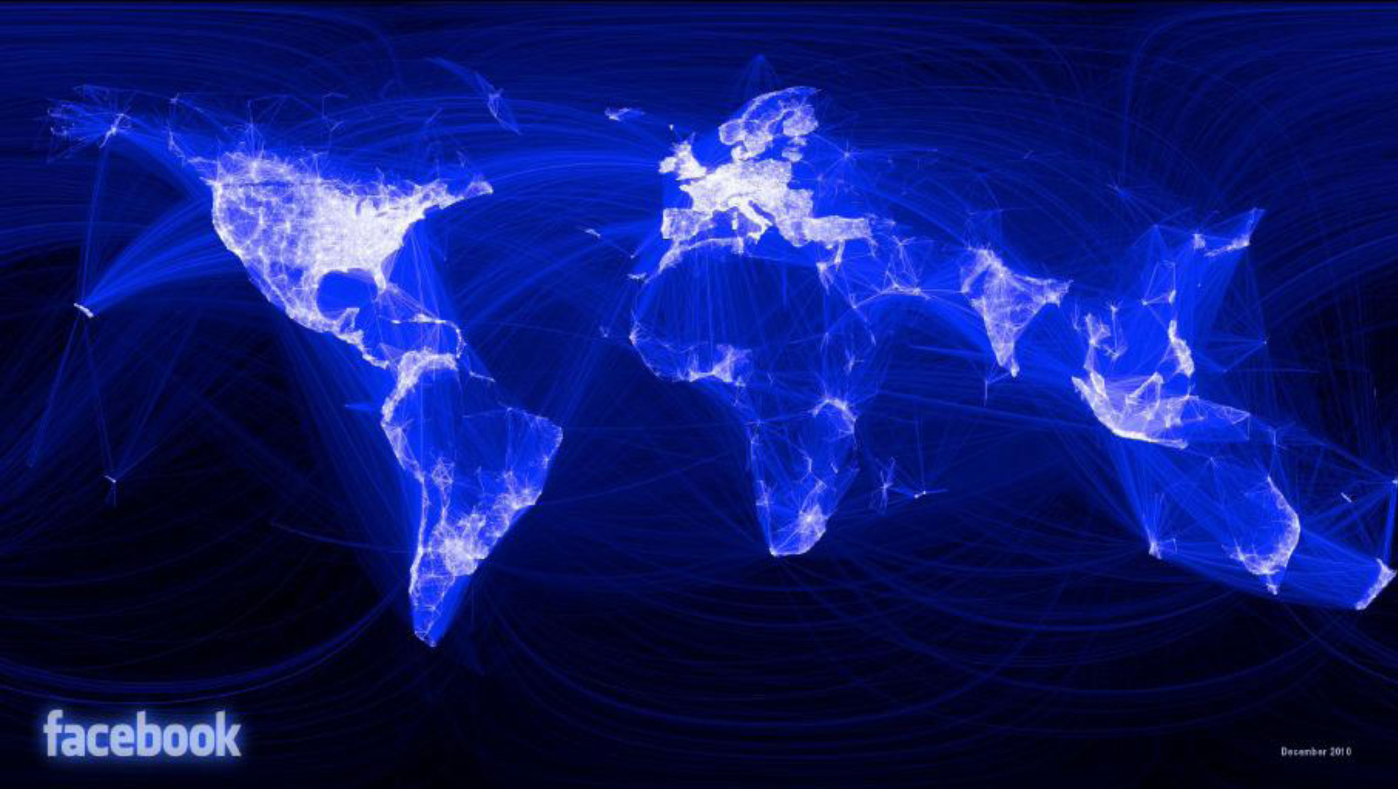
…fast forward 2500 years

Slide 26
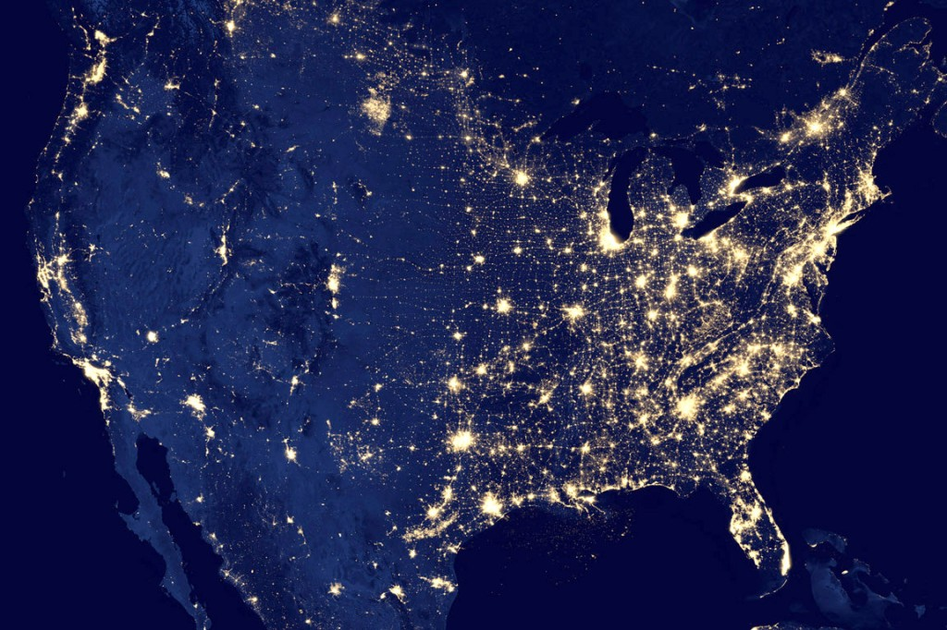
The Semantic Web
The Web is a vast and growing
distributed knowledge base…
How to use it better?
Metadata and keywords were a start
Controlled vocabularies: an improvement, but can do more with today’s technology
Ontologies: based on W3C standards—RDF, SKOS, RDFS, OWL
Reasoners: based on formal logic

Slide 27
LOTS OF DATA!
How do we know if data sets are measuring the same TYPES of things or phenomena?
Productivity
Biodiversity
Temperature
Water temperature
Surface water temperature
Surface water temperature in degrees Celsius
Surface water temperature in degrees Celsius taken from a stream surrounded by a wildfire

Slide 28
Some Semantic Concepts
Definitions!!
*Controlled vocabularies: defined (NL) terms that clarify or constrain the meaning of what you are indicating or asserting. Also called glossaries or lexicons
*Thesauri: adds some features– like synonyms (same as), antonyms (opposite of), related-to (flexible, blurry, but useful).
*Ontologies: adds additional features such as: strict Class/SubClass (is_a), various properties/relationships to inter-relate objects: part_of, friend_of, sibling_of (that has subProperty “sister_of”)

Slide 29
Semantic Standards
Facilitate machine-to-machine information exchange; ideally “universal interpretation”, e.g.
HTML rendering by Web browsers
Today, that exchange takes place over the Web –
our global information hi-way
World Wide Web Consortium (W3C) recommendations:
HTML
XML/XMLS
RDF
OWL

Slide 30
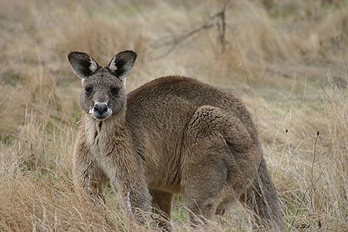
How can ontologies help?
Can “Define” Objects with equivalence classes
Specifies Necessary and Sufficient Conditions
Reasoner will classify described Object
has Fur
locomotes Bipedal
native_to Australia
births UndevelopedYoung
has GoodJumpingAbility
Notes:
ACKNOWLEDGE: very simple examples (this slide is primarily for people who aren’t that familiar with ontologies)
Data set discovery:
Concept classification
Concept matching
Data set merging:
Emergent concepts:
Potential analyses:

Slide 31
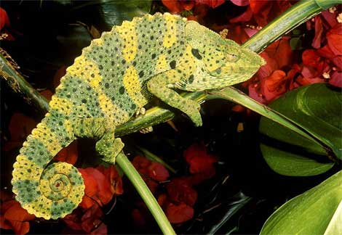
Semantic Data Integration
Can express complex constructs:
SLA is an abbreviation that is a synonym for the functional trait called Specific Leaf Area that is a measurement taken from a leaf, which is a part of a plant
SLA consists of a dry weight measurement divided into an areal measurement
Can natively reason:
The specimen has a prehensile tail, extrusible tongue, eats insects, has fused toes
infer: specimen is a chameleon
infer: chameleon is a reptile
infer: specimen has stereoscopic eyes
Infer: specimen may be able to change color

Slide 32
Some Semantic Concepts
Universals vs particulars (classes vs instances)
Typically, your data values, and the specific objects/ specimens that these describe, are instances:
But it isn’t always clear:
Alpinia purpurata is an accepted name for a species of plant. We could model Alpinia purpurata as a “class” where its instances are all specimens that *are* Alpinia purpurata. Or, we could consider Alpinia purpurata the instance consisting of all its constituent parts, much like we consider ourselves an “instance”, much to the chagrin of our cellular components.

Slide 33
Some Semantic Concepts
Universals vs particulars (classes vs instances)
Typically, your data values, and the specific objects/ specimens that these describe, are instances:
The name Alpinia purpurata in a dataset (potentially) references a particular individual, as observed in some natural setting. This is often called an “occurrence”, and it is an “instance”.

Slide 34
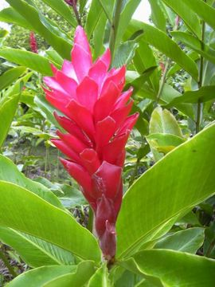
Example biodiversity data
(I) saw an individual of Alpinia purpurata in plot 1 on Oct. 11, 2009.
It was 35cm high with mean specific leaf area of 3.6. The valley it was located in has mean annual precipitation of 430mm, and a
mean monthly temperature for October of 23 degrees Celsius.
(I) saw an individual of Anthurium andreanum in plot 1 on Aug. 10, 2009.
It was 24cm high with a specific leaf area of 4.2. The general area has mean annual precipitation of 220mm, and a mean monthly temperature for August of 32 degrees Celsius.
….etc…
Sz | Loc | Plt | Spname | Date | Lf | Temp | Rn
35 | A | 1 | Alpipurp | 111009 | 3.6 | 23 | 430
24 | C | 1 | Anthuand | 100809 | 4.2 | 32 | 220
43 | B | 4 | Anthuand | 080910 | 6.4 | 14 | 102
139 | A | 2 | Alpipurp | 091011 | 3.9 | 19 | 40

Slide 35
Implicit Semantics: RDF can reveal!
“I saw an individual of Alpinia purpurata in plot 1 on Oct. 11, 2009. It was 35cm high with a specific leaf area of 3.6. The valley it was located in has mean annual precipitation of 430mm, and a mean monthly temperature for October of 23 degrees Celsius.”
Alpinia purpurata (Vieill.) K. Schum
Missing semantics: What do “Sz”, “Spname” and “Lf” stand for?
Was the SLA (coded here as Lf) normative or measured on some specimen?
What was basis for associating Temp and Rn with this observation?
What is SCOPE for use of string “Alpipurp”? For “Loc”, “Plt”?: need namespaces
Sz | Loc | Plt | Spname | Date | Lf | Temp | Rn
135 | A | 1 | Alpipurp | 111009 | 3.6 | 23 | 430
24 | C | 1 | Anthuand | 100809 | 4.2 | 32 | 220

Slide 36
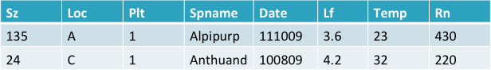
Subject: “Row 1” Predicate: Spname Object: Alpipurp
Subject: “Row 1” Predicate: Lf Object: 3.6
Subject: “Row 1” Predicate: Sz Object: 135
Problem1: how can these triples be found on the Web?
Problem2: how do we know what “Spname”, “Lf”, and “Sz” stand for?
Problem3: how do we know what “Alpipurp”, 3.6, and 135 are?

Slide 37
RDF-izing (triplifying) a Table
RDF: Resource Description Framework
basic data model: SUBJECT (s), PREDICATE (p), OBJECT (o)
Subject: “Row 1” Predicate: Spname Object: Alpipurp
Subject: “Row 1” Predicate: Lf Object: 3.6
Subject: “Row 1” Predicate: Sz Object: 135
But we want to expose these data to the Web…

Slide 38
Linked (Open) Data– LOD for the Web:
Tim Berners-Lee’s four principles of LOD:
Use URI’s to identify things: as Subjects, Predicates, or Objects.
Use HTTP URIs so that these things can be looked up over the Web (“dereferenced") by people and user agents
Provide useful information about the thing when its URI is dereferenced, using standard formats such as RDF/XML.
Include links to other, related URIs in the exposed data to improve discovery of other related information on the Web.
(above 4 points from Wikipedia article on “Linked Data”, accessed 9 Feb 2013)

Slide 39

The Semantic Web
Pete DeVries’ has a great slideset about Linked Open Data for Biodiversity
http://www.slideshare.net/pjdwi/biodiversity-informatics-on-the-semantic-web
Visualization of Linked Open Data cloud on the Web as of Sep, 2011—from Wikipedia

Slide 40

OWL “Web Ontology Language”
W3C recommendation
http://www.w3.org/TR/owl-features/
Many logical features:
Union, equivalence, domain/range constraints
Excellent tutorial:
http://owl.cs.manchester.ac.uk/tutorials/protegeowltutorial/

Slide 41
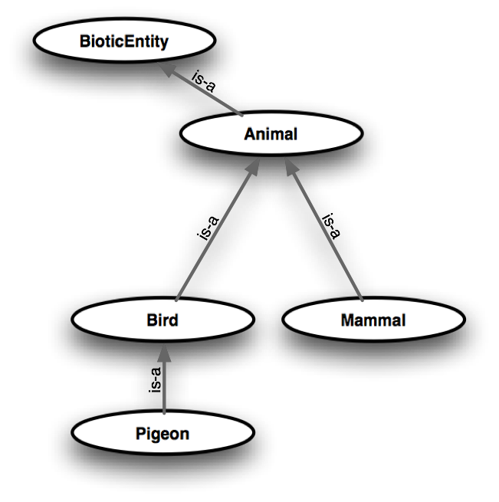
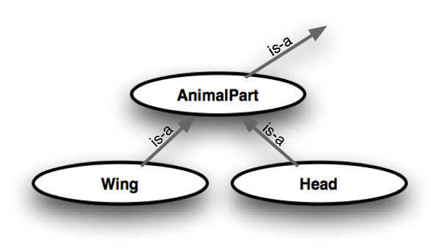
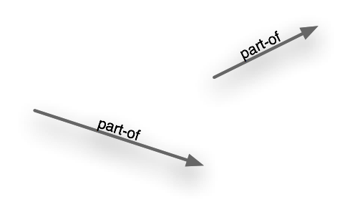
What is an ontology?
Generally, a formal specification of concepts, and the relationships that may exist between those concepts.

Slide 42
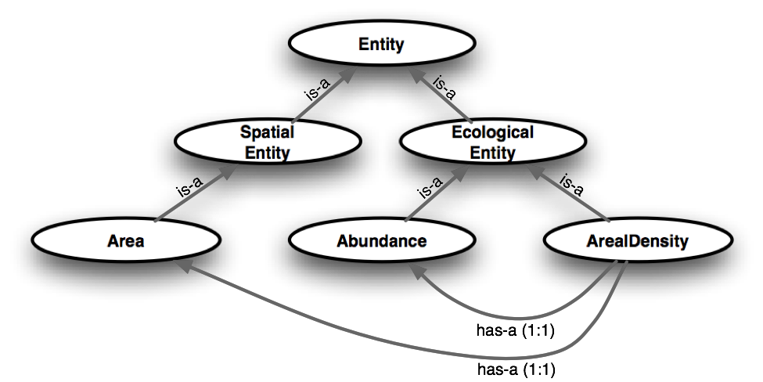
How can ontologies help?
Classification and “reasoning”
New “facts” derived from ontology
Potential emergence
ArealDensity requires knowledge of Area and Abundance
Notes:
ACKNOWLEDGE: very simple examples (this slide is primarily for people who aren’t that familiar with ontologies)
Data set discovery:
Concept classification
Concept matching
Data set merging:
Emergent concepts:
Potential analyses:

Slide 43
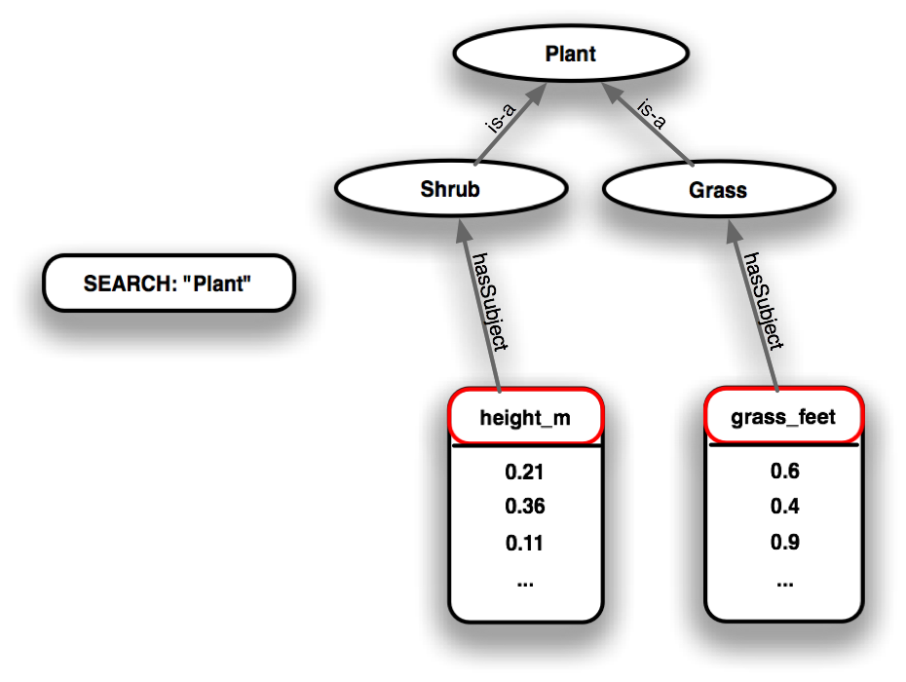
How can ontologies help?
Classification and “reasoning”
Data discovery
Finding relevant data sets
Understanding data set content
Notes:
ACKNOWLEDGE: very simple examples (this slide is primarily for people who aren’t that familiar with ontologies)
Note ability to search for a concept (e.g. Plant) which is not explicitly in the data or metadata. That concept is drawn from an ontology (which provides a controlled meaning and network of relationships for that concept). The data or metadata must be annotated with the concept (or some concepts or property descriptions that ultimately relate the stated concept to the data or metadata).
Data set discovery:
Concept classification
Concept matching
Data set merging:
Emergent concepts:
Potential analyses:

Slide 44
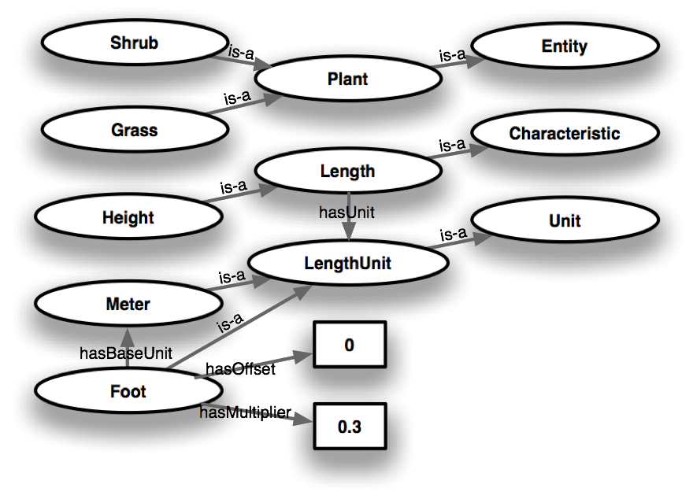
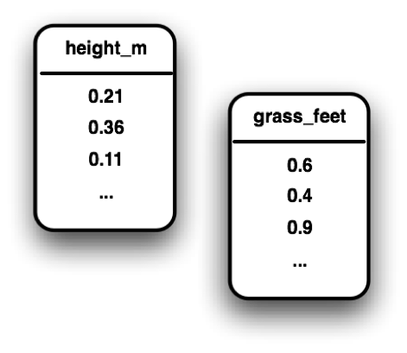
How can ontologies help?
Classification and “reasoning”
Data discovery
Integration/merge
Concept mapping
Units conversion
Spatial & temporal scaling
Notes:
ACKNOWLEDGE: very simple examples (this slide is primarily for people who aren’t that familiar with ontologies)
Data set discovery:
Concept classification
Concept matching
Data set merging:
Emergent concepts:
Potential analyses:

Slide 45
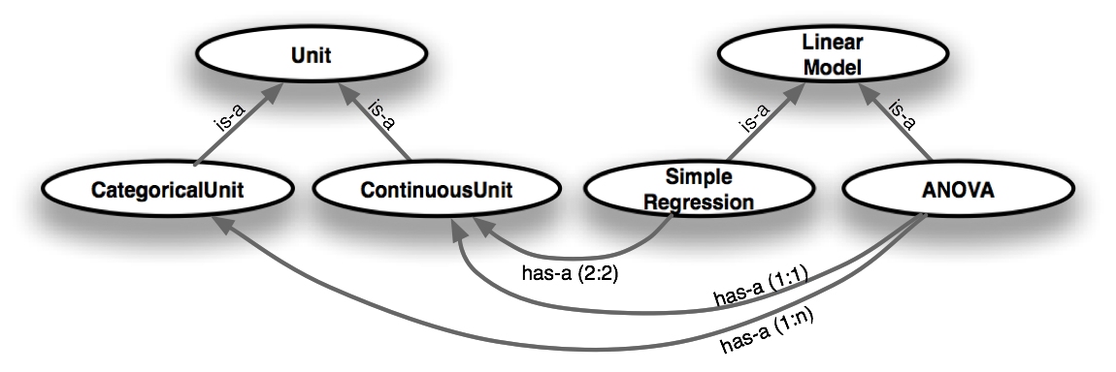
How can ontologies help?
Classification and “reasoning”
Data discovery
Integration/merge
Analytical assistance
Statistical inference
Data types
Data transformations
Notes:
ACKNOWLEDGE: very simple examples (this slide is primarily for people who aren’t that familiar with ontologies)
Data set discovery:
Concept classification
Concept matching
Data set merging:
Emergent concepts:
Potential analyses:

Slide 46
DataONE/KNB/SONet/Semtools Semantic Approach
Data-> metadata-> annotations-> ontologies
Annotations link EML metadata elements to concepts in ontology thru Observation Ontology
EML metadata describe data and its structures

Slide 47
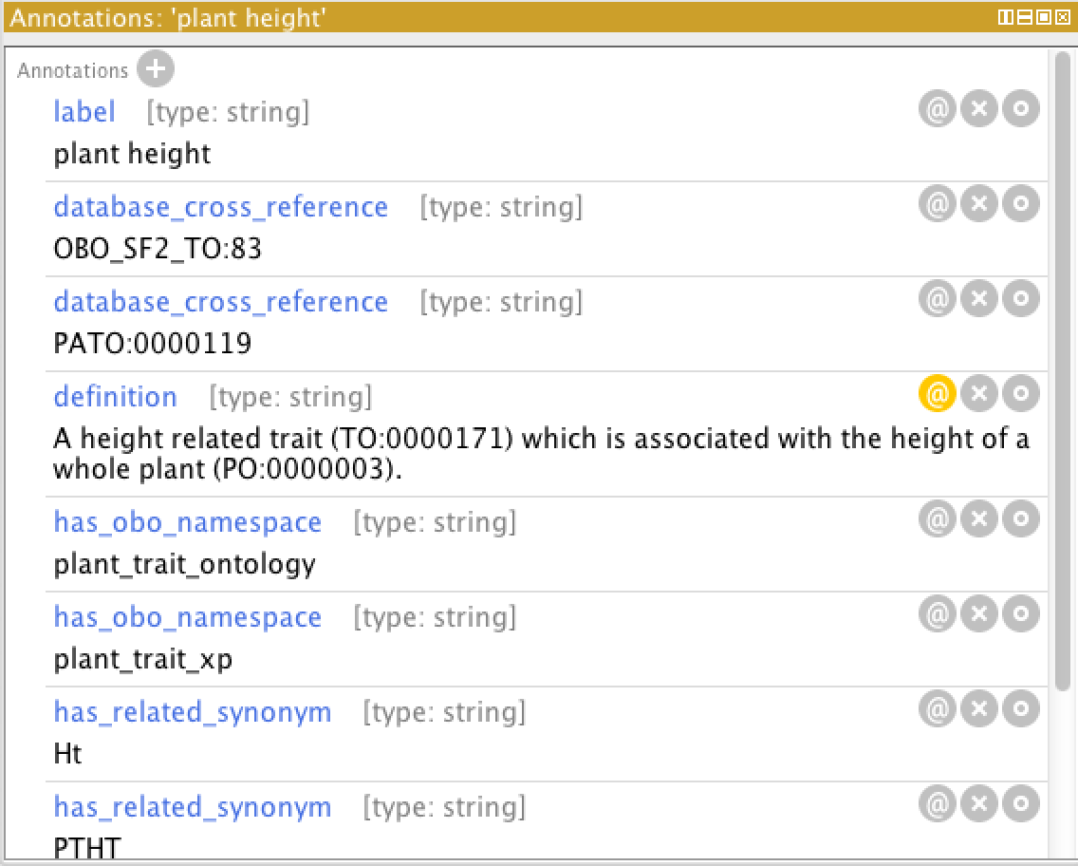
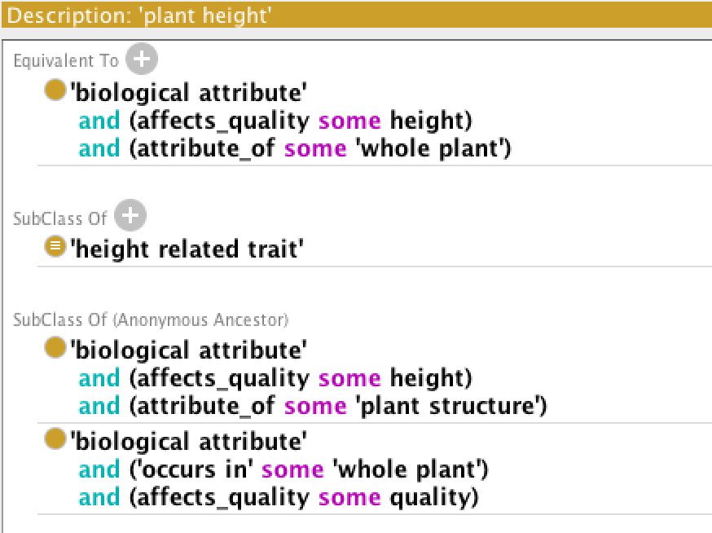
Definition of Plant Height (TO)

Slide 48
Semantic Annotation
Apply semantic annotation to data attribute of
“veg_plant_height”
Characteristic (height)
Entity (whole plant)
Standard (Meters) terms from Observation Ontology (OBOE.OWL) terms from Domain Ontology (TO.OWL)

Slide 49
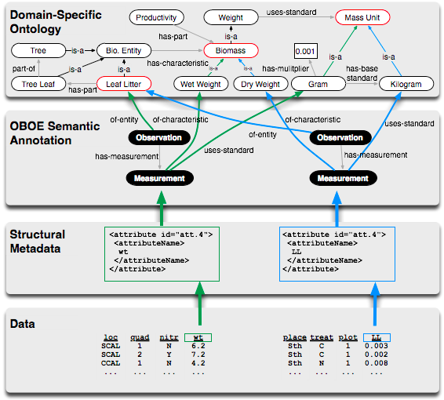
Semantic annotation
Attribute
mappings

Slide 50
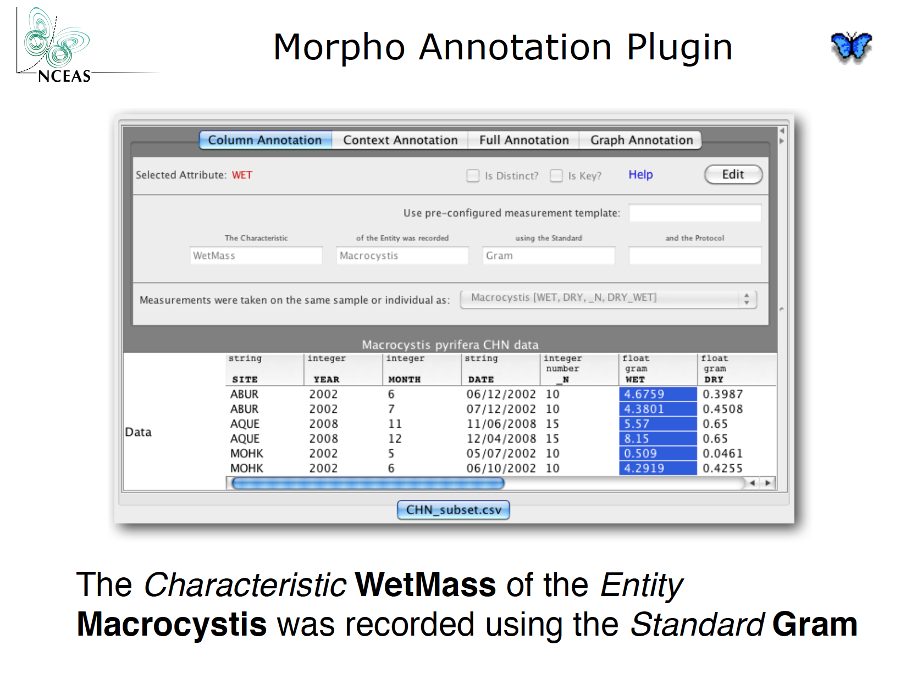
Enabling Semantic Annotation

Slide 51
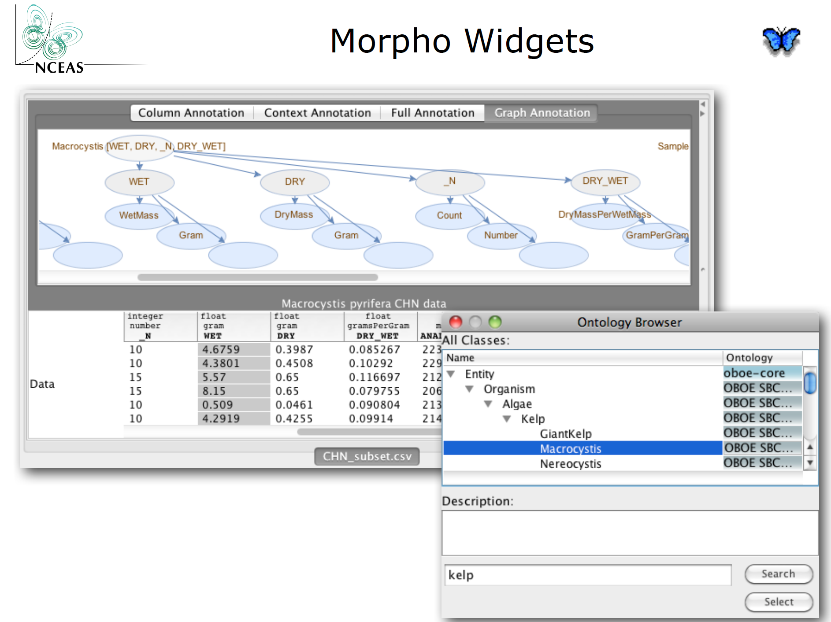
Enabling Semantic Annotation

Slide 52
Hiding the complexity
Interface challenges!
How to enable scientists
to easily annotate (their data),
as well as discover concepts,
based on ontologies
Reasoning happens on the
back-end

Slide 53
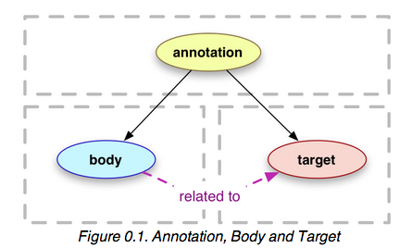
Open Annotation Ontology*
Data-> metadata-> annotations-> ontologies
Use “Open Annotation Ontology” to annotation EML metadata with domain ontology concepts
* http://www.openannotation.org/spec/core/20130208/index.html

Slide 54
Design Pattern--Observational Data Model
DataONE/SEEK’s OBOÉ
Strive for close compatibility with OBO EQ/PATO, OGC O&M
Context
*
ObservedEntity
*
Observation
Entity
*
1..1
1..1
1..1
*
Value
Measurement
*
+ precision : decimal
+ method : anyType
*
1..1
Characteristic
0..1
*
*
0..1
Protocol
Standard

Slide 55

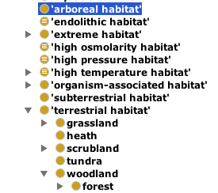
Developing and evaluating ontologies
Domain scientists must work with knowledge modelers to get it right
Easy to find existing ontologies that contain questionable modeling
Mean is NOT synonymous with Average;
It is one type of Average (subClass of… ?)
While Climate is a statistical assessment of meteorological measurements over long-time periods, it may not be useful (e.g. for querying) to classify it as an “Average” in the Knowledge Model
No relation?!

Slide 56








How We Will Get There
Develop an integrated semantic platform that follows software engineering best practices and semantic web methodology and standards
Combine machine-automated with manual approaches to semantic annotation
Enhance pipeline for text-mining scientific literature to improve ontology contents and structure
Extend demonstration use cases with geosemantic search capabilities, and better support for annotation and ingest
What? OWL-DL/OBOÉ, OA
From where? PROV-O, OA
DwC, EML, ISO

Slide 57
Conclusion
The W3C is developing new languages (RDF, OWL) that allow us to precisely define concepts in a rigorous, logical framework
These concepts are stored and arranged in Internet-accessible Ontologies, that are highly interoperable in the same way that HTML allows for standardized processing by different browsers or other applications
Ontologies also enable some machine processing, due to the complex logical axioms that can be specified in them
We can “bind” our data to concepts defined in Ontologies, through a process known as “semantic annotation”
Doing so will hopefully enable a new standard for data discovery and interoperability throughout the Web.

